Slide 1
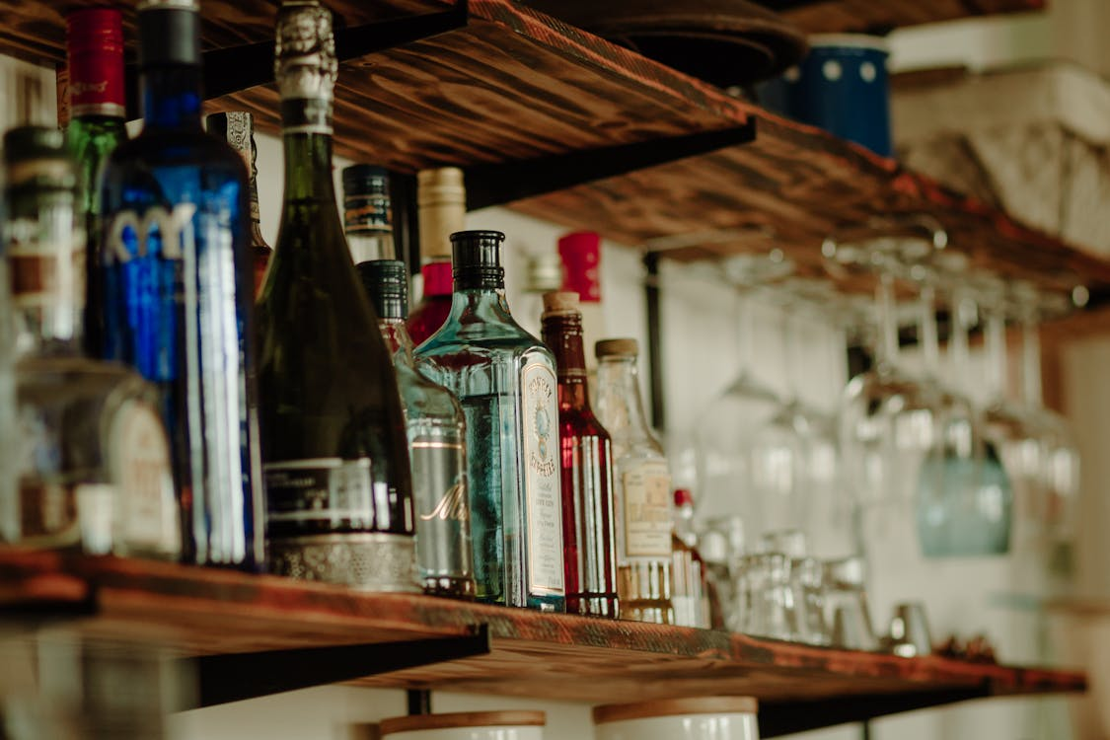
Preliminary Opportunities: Asterisk Vodka
***
May 2024
Notes:
https://www.pexels.com/photo/assorted-labeled-bottle-on-brown-shelf-2198400/

Slide 2
Exploratory Marketing Overview
***
Asterisk:
American food grade producer of high proof spirits
Conversion from industrial to direct consumer sales
800kL production annually
Exploratory analysis: Where should global marketing start their next steps?
What
Who
price point
demographics
Where
targeted marketing
Notes:
We pulled from….

Slide 3
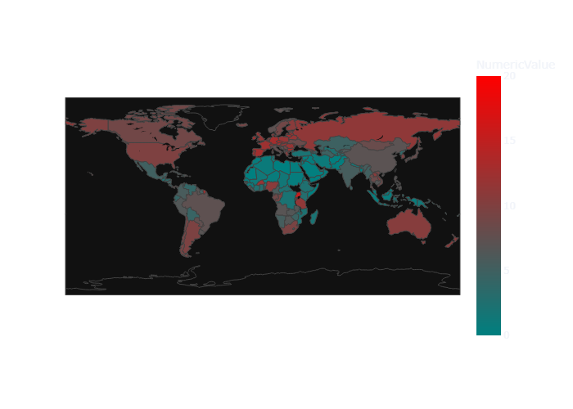
Where is Alcohol Consumption Highest?
***
Europe– 9.1 L
Other
Americas- 6.6 L
Africa- 5.2 L
Western Pacific- 4.5 L
SE Asia- 3.1 L
Middle East - .8 L
Notes:
2018 data frame

Slide 4
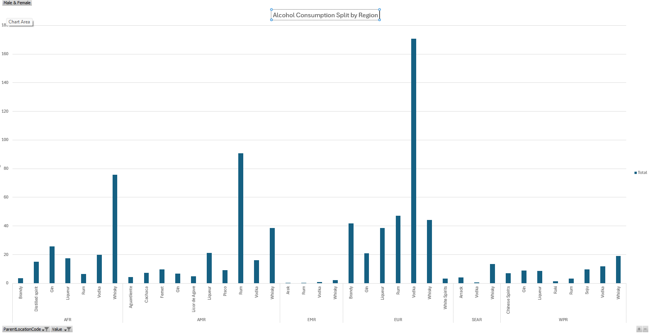
Who Drinks Vodka over other Spirits?

Slide 5
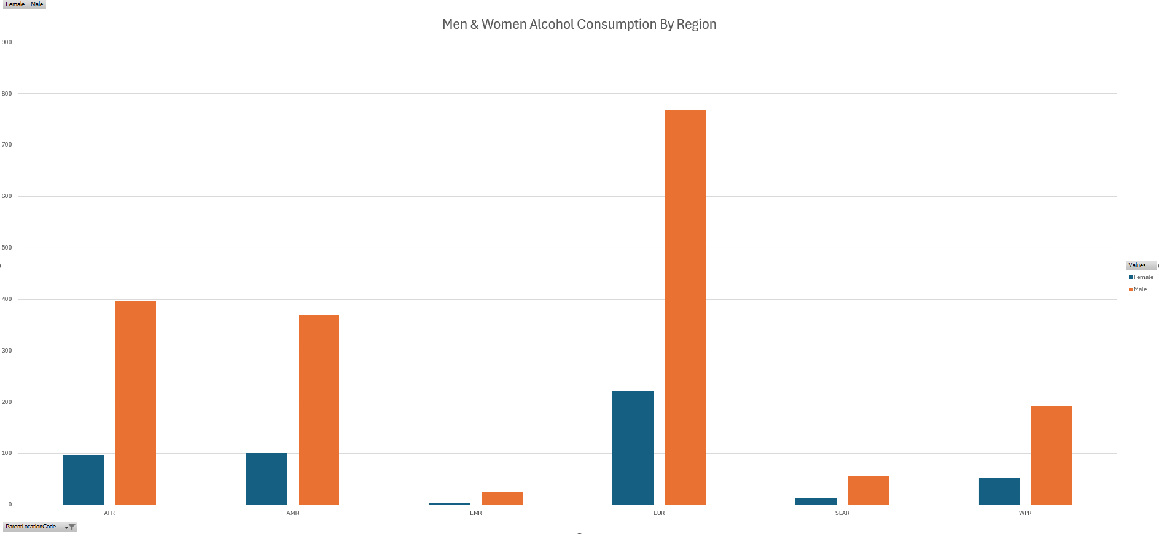
Where and Who: Regional Consumption by Gender
***

Slide 6
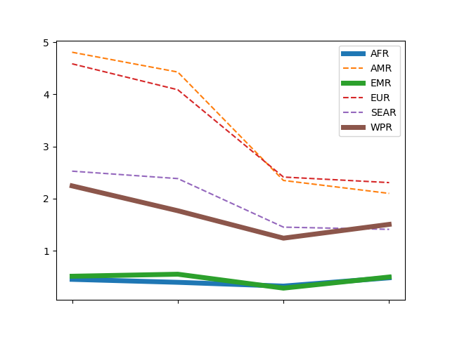
Spending : Regional Spending Trends
***

Slide 7
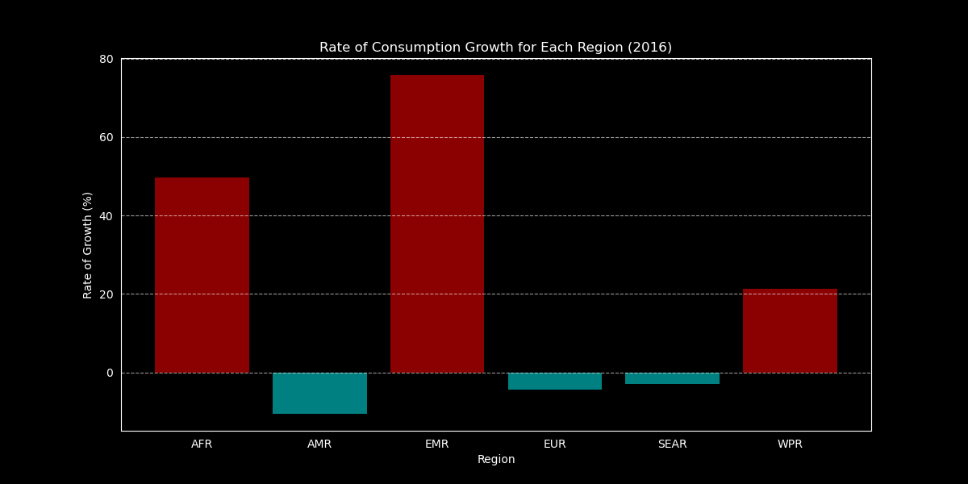
Spending : Regional Spending Growth
***
Africa and Western Pacific and Middle East all experiencing growth.
We rejected the Middle East due to the per capita spend and size of the market.

Slide 8
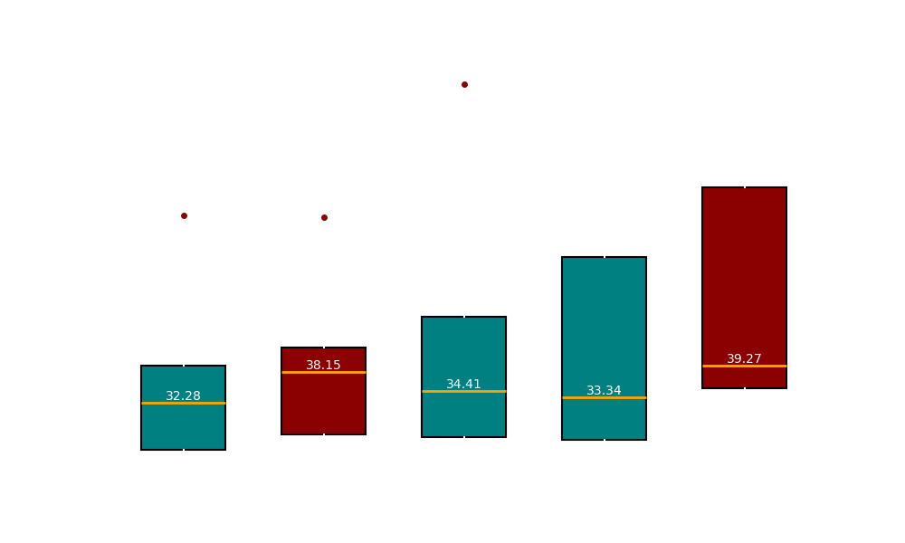
Price: Regional Prospects (median+ var)
***
Notes:
Find median pricing in AUS and Canada

Slide 9
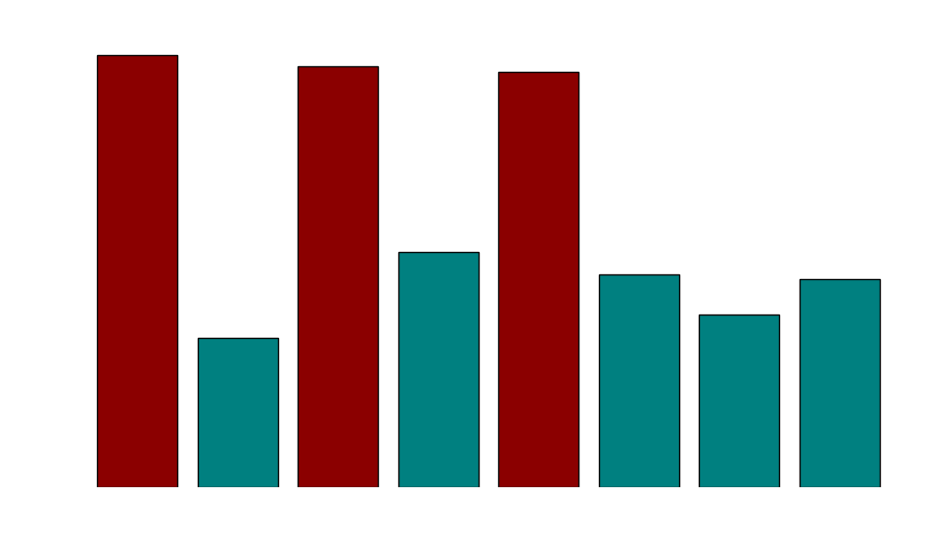
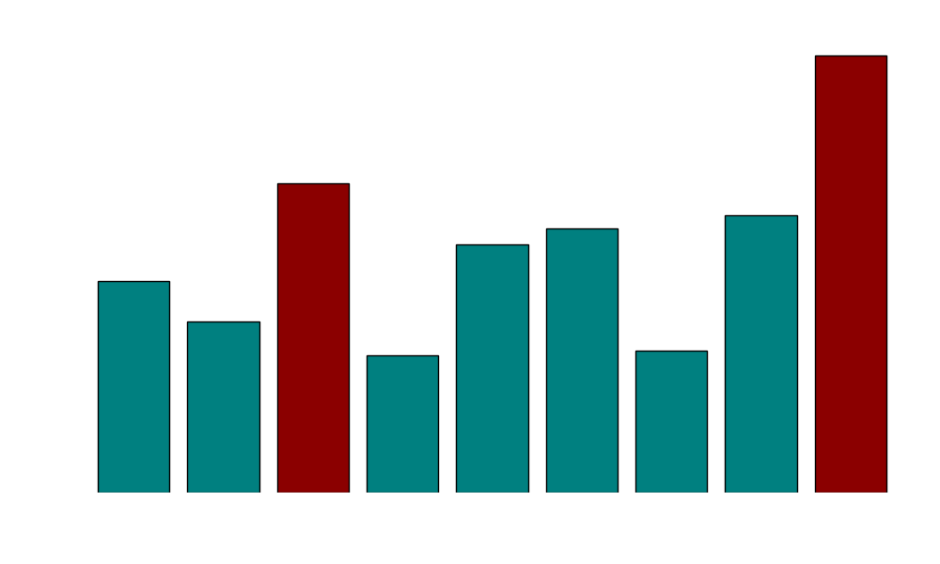
Price: Regional Prospects (Avg)
***
TARGET? Australia, Kiribati, Canada, Malaysia, and Argentina
Australia and Canada the most exciting prospects
Kiribati- small market 121k people
Malaysia- cultural taboos
Argentina- macreconomic concerns
Europe- geopolitical concerns
Notes:
Find median pricing in AUS and Canada

Slide 10
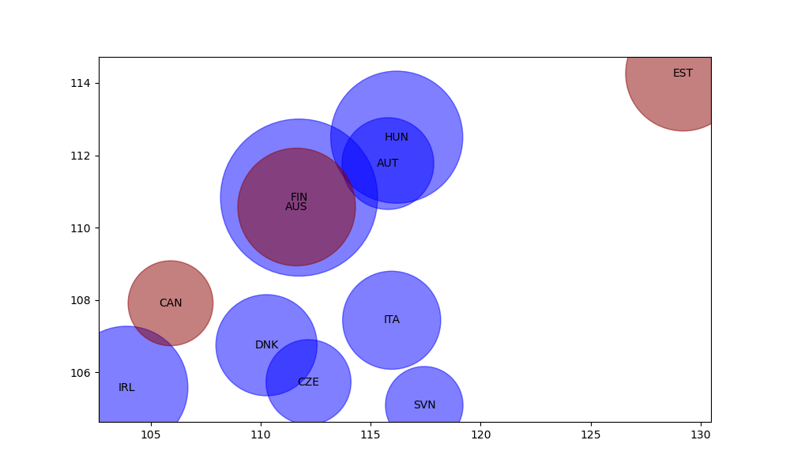
Spending : Regional Spending Growth
***
Estonia exciting price growth (developing)
Cultural demand (Russian influence)
Small Population
Median price
Australia and Canada highest growth in price outside of the European market
Limitations- Africa, Asia, Middle East underrepresented in OECD Data
Notes:
Fix the bubble map to show circles that have populations over 20M people as red

Slide 11
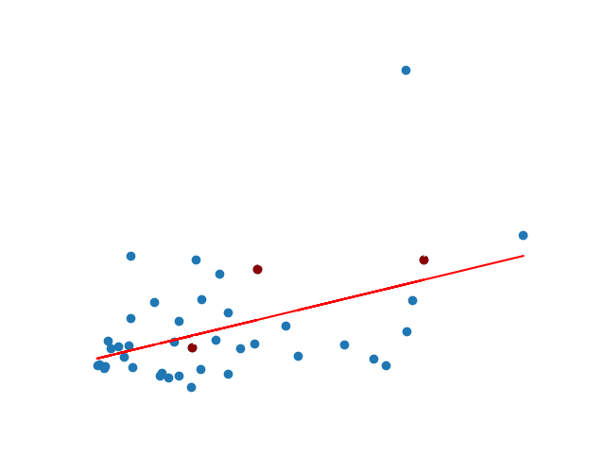
Price: Spirits vs other Alcohols
Spirits tend to cost more than other alcohols.
In Canada and Australia this gap is narrower that in Estonia, suggestion room for price growth in Estonia
Overall price point is much lower in Estonia, suggesting more research is needed into actual margins in the region that might be skewed by tax or cheap production costs etc.

Slide 12
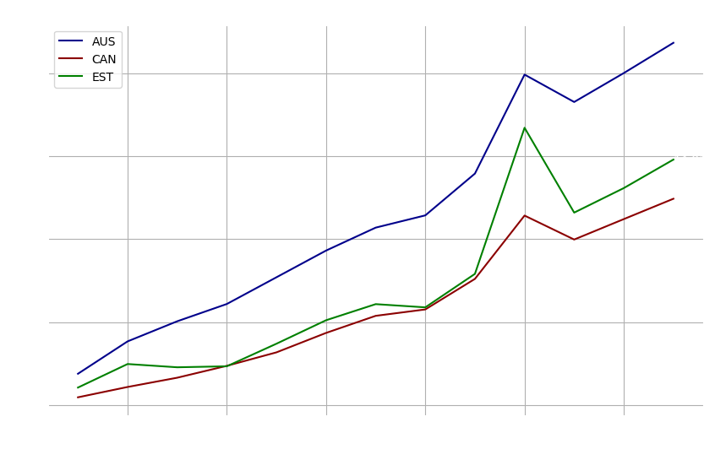
Target Pricing- Linear Forecast
With +/-20% range
AUS- $17.59-26.23
EST- $11.85-17.78
CAN- $9.96-14.94
Notes:
Using CPI data for the three target countries, we multiplied 2012 base price by the base year CPI growth, then forecast linearly from 2022 to 2025.

Slide 13



Recap: Recommended Targets
***
Canada
440 miles
35M population
Solid price average
Australia
10k miles
26M population
High price average
Estonia
4132 miles
1.3Mpopulation
Fast Growth
COUNTRY | Total Alcohol Consumption | Spirits % | Total Spirits | Asterisk Market %
AUS | 249431247 | 1% | 3117891 | 26%
EST | 10906558 | 8% | 841986 | 95%
CAN | 583966958 | 2% | 12263306 | 7%

Slide 14
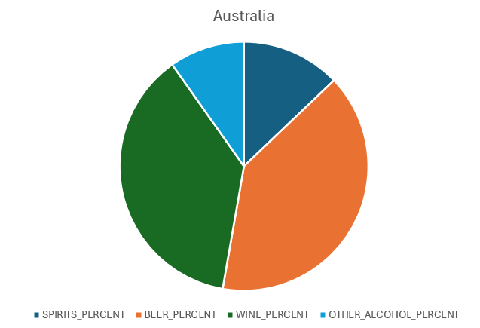
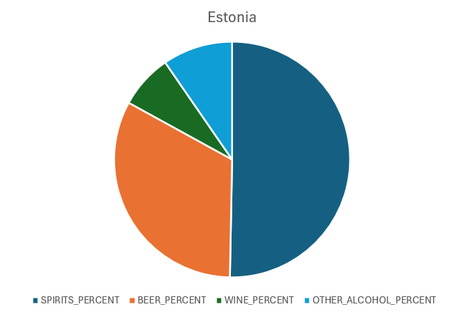
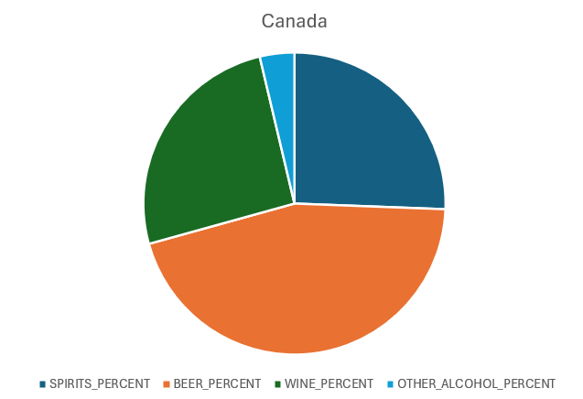
Who is buying what?

Slide 15
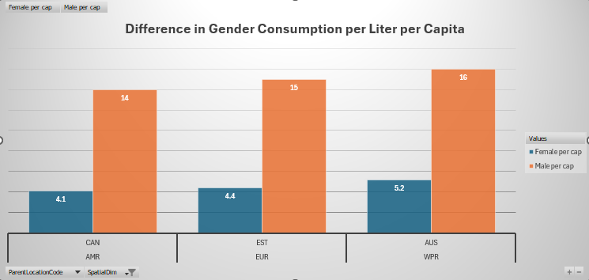
Who Drinks in the Target Country?
***
On average, every weekend, Canadian, Australian, and Estonian men drink a fifth….
Not a FACT: Average Texas Tech student drinks this before breakfast.

Slide 16
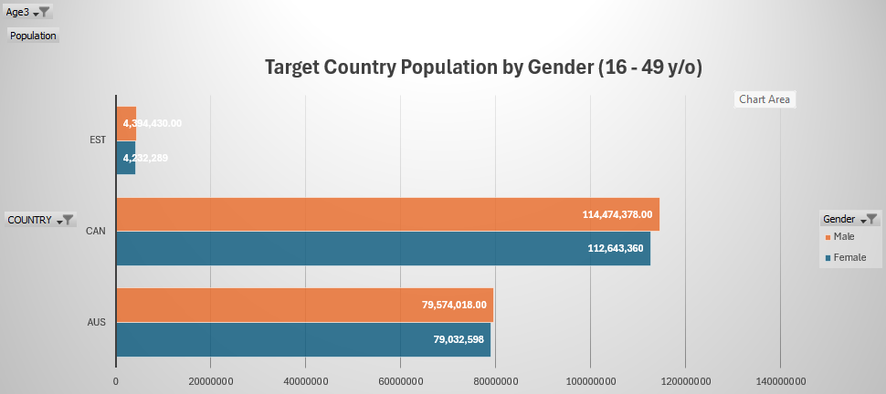
Target Countries: Drinking Age Consumers
NOTE: Women make up a higher percentage of the total population in all age ranges. Women skew older.

Slide 17
Limitations and Further Research
***
Who is buying | Women or men? Which is the BUYER vs CONSUMER
Language Barrier | Estonia vs Canada vs Australia
Brand/ National loyalty | Are there patriotic or othe reasons for spirit popularity and consumption.
Age Range | What is the legal drinking age and how does that affect consumption patterns
Accessibility | Distance to point of sale, ecommerce, express couriers
Competition | Cosmetics, industrial,and other brands
Foreign Exchange Rate | Fluctuations and hedging requirements, double ledgering
Tax Environment | What proportion of cost and price is tax? Is that tax producer, seller, or consumer burden?
Macroeconomic Environment | Conflicts and recessions
Distribution and Logistics | Shipping cost and time it takes to get to consumer from production facility (US)
Seasonality | Drill down needed to determine the best time of year to launch based on chosen country seasonal trends
Wage Growth | Where is growing markets? What is income per capita, income median, and how is that structured for our market audience in each country
Underlying Data Age | As more data becomes available for 2024, clearer pictures can be made

Slide 18
Resources
https://www.statista.com/statistics/256598/global-inflation-rate-compared-to-previous-year/
https://genderdata.worldbank.org/en/indicator/sh-alc-pcap-li
https://www.who.int/data/gho/info/gho-odata-api- "drinks.csv“
https://gist.github.com/aegorenkov/f7f0f8d6e9cc17ca9774572e224e2ad14- PLotly map-making help
https://www.datacamp.com/tutorial/making-map-in-python-using-plotly-library-guide
https://stats.oecd.org/Index.aspx?DataSetCode=SNA_TABLE5_ARCHIVE
https://data.oecd.org/pop/population.htm

Slide 19
DRINK RESPONSIBLY

